Slide 1
Integrating Data-Level Balancing and Enhanced RFM-Based Feature engineering for Credit Card Fraud Detection
Student Name: Andy Chen, Alvin Lin, Chrissy Wang
Advisor Name: Hui Wen Teng
2025 Machine Learning & Fintech

Slide 2
Introduction
Data
Methodology
Results
Conclusion
Integrating Data-Level Balancing and Enhanced RFM-Based Feature engineering for Credit Card Fraud Detection

Slide 3
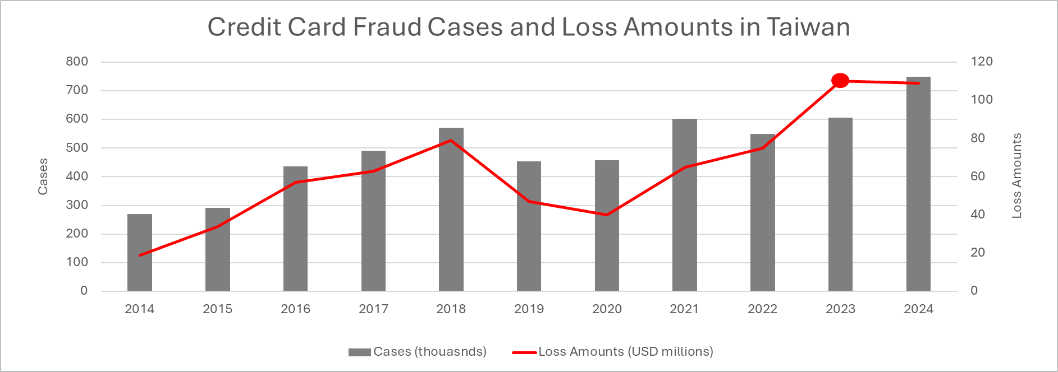
1. Introduction
Importance of Credit Card Fraud Detection
World: Fraud losses reached US$ 33.83 billion in 2023 and US$33.45 billion in 2022.
United States: Losing over US$10 billion to fraud in 2023 with a 14% increase from 2022.
Europe: Fraud totaled US$4.9 billion in 2022.
Taiwan: Fraud losses hit US$110 million in 2023, the highest in a decade.
Integrating Data-Level Balancing and Enhanced RFM-Based Feature engineering for Credit Card Fraud Detection
Notes:
Let’s start with why this topic is important. In recent years, fraud losses have posed serious challenges across various regions.
In Taiwan specifically, both the number of cases and the total amount of losses have increased year by year and we reached 110 million US dollars in 2023, which is the highest in the past decade.

Slide 4
1. Introduction
Characteristics of Fraud Detection
(Bart Baesens et al., 2021)
Concealed
Carefully planned and hard to capture by fixed rules.
Rare
Low occurrence causes class imbalance and weak learning.
Evolving
Continuously changing, requiring model adaptability.
Feature Engineering
Imbalanced Learning Techniques
Integrating Data-Level Balancing and Enhanced RFM-Based Feature engineering for Credit Card Fraud Detection
Notes:
Let’s start with why this topic is important. In recent years, fraud losses have posed serious challenges across various regions.
In Taiwan specifically, both the number of cases and the total amount of losses have increased year by year and we reached 110 million US dollars in 2023, which is the highest in the past decade.

Slide 5
1. Introduction
Feature engineering frameworks in fraud detection
RFM framework
(Bart Baesens et al., 2021) (Xinwei Zhang et al., 2019)
Component | What It Measures | Fraud Detection Insight
Recency | How recently a customer performed a specific type of transaction. | Long gaps in expected behavior may indicate suspicious activity.
Frequency | How often a customer makes certain types of transactions within a time window (e.g., 90/180 days). | Sudden surge or drop to zero may signal abnormal or fraudulent activity.
Monetary | The total or average amount of money spent in transactions over a given period. | Unusually high amounts can be a strong fraud indicator.
Integrating Data-Level Balancing and Enhanced RFM-Based Feature engineering for Credit Card Fraud Detection

Slide 6
1. Introduction
Imbalanced Learning Techniques
(Spelmen et al., 2018)
Imbalanced Data
Data Level
Algorithm Level
Hybrid
Oversampling
Under-sampling
Feature Selection
One Class Learning
Cost Sensitive Learning
Ensemble Methods
Mixture of Experts Algorithms
Integrating Data-Level Balancing and Enhanced RFM-Based Feature engineering for Credit Card Fraud Detection
Notes:
Let’s start with why this topic is important. In recent years, fraud losses have posed serious challenges across various regions.
In Taiwan specifically, both the number of cases and the total amount of losses have increased year by year and we reached 110 million US dollars in 2023, which is the highest in the past decade.

Slide 7
2.1 Data
Financial Transactions Dataset: Analytics
Dataset Overview
Source: Kaggle
Duration: 2010/01/01~2019/10/31
Size: 13,305,915 Observations (Only 8,914,963 have labels)
Composition
Source datasets (5):
Transaction
User
Credit Card
Train_Fraud_Labels
MCC_Codes
Columns: 37 (expanded to 51 after one-hot encoding and missing value imputation)
Target labels: fraud_label
Overall Fraud Rate: 0.100% (0.149% among labeled samples)
Integrating Data-Level Balancing and Enhanced RFM-Based Feature engineering for Credit Card Fraud Detection

Slide 8
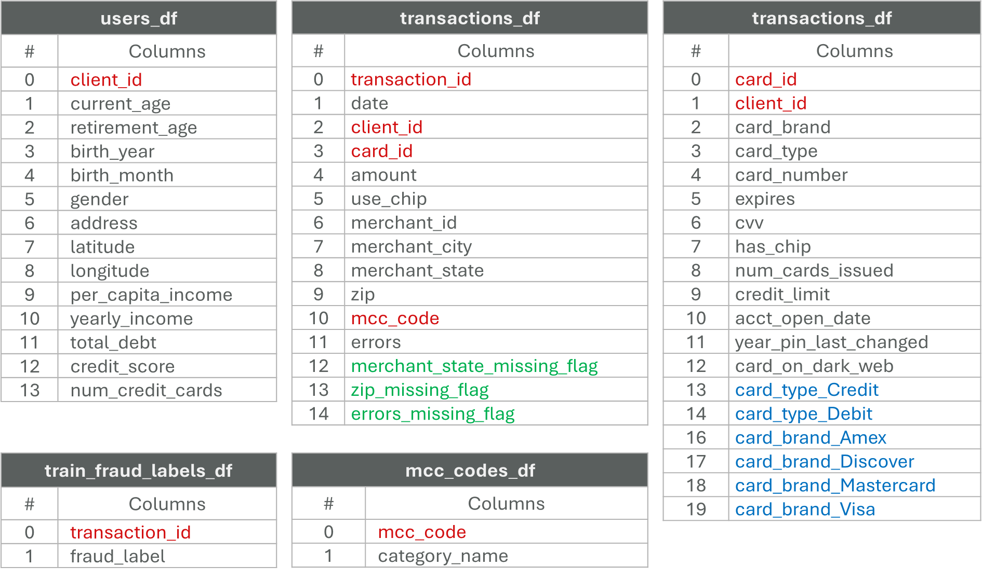
2.1 Data
Source columns
Red: join Key | Green: missing_flag | Blue: one hot encoding
Integrating Data-Level Balancing and Enhanced RFM-Based Feature engineering for Credit Card Fraud Detection

Slide 9
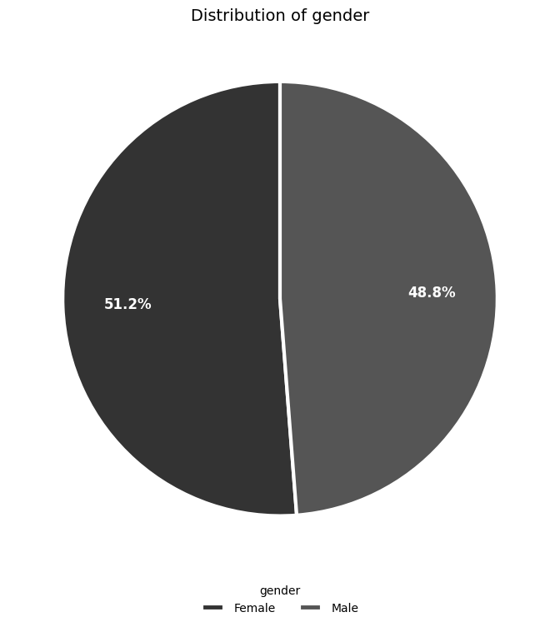
2.2 Data Exploration
Categorical Variables—Consumers’ Gender
Gender | Frequency
Female | 6,815,916 (51.22%)
Male | 6,489,999 (48.78%)
Integrating Data-Level Balancing and Enhanced RFM-Based Feature engineering for Credit Card Fraud Detection

Slide 10
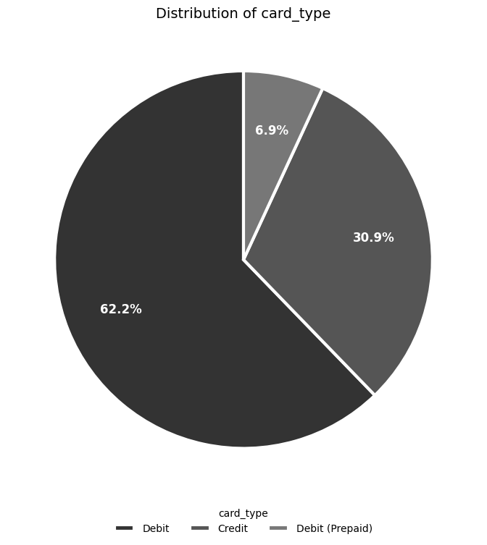
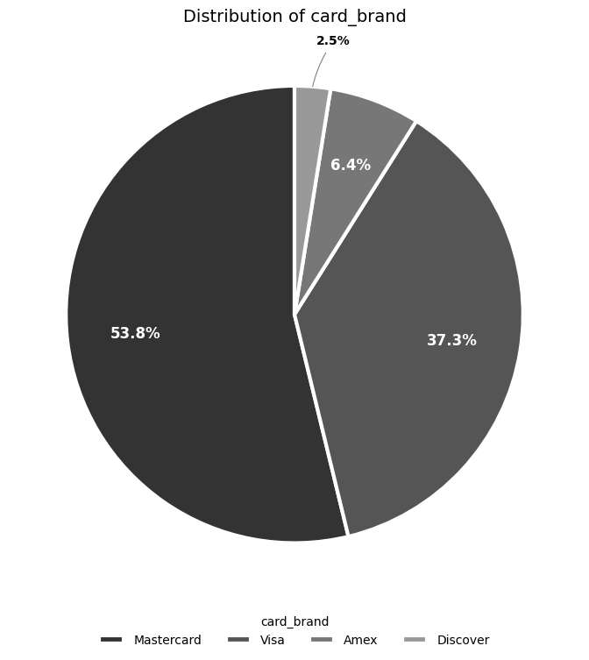
2.2 Data Exploration
Categorical Variables—Card Information
Card Type | Frequency
Debit | 8,280,996 (62.24%)
Credit | 4,109,189 (30.88%)
Debit (Prepaid) | 915,730 ( 6.88%)
Card Brand | Frequency
Mastercard | 7,157,399 (53.79%)
Visa | 4,957,563 (37.26%)
Amex | 854,490 (6.42%)
Discover | 336,463 (2.53%)
Integrating Data-Level Balancing and Enhanced RFM-Based Feature engineering for Credit Card Fraud Detection

Slide 11
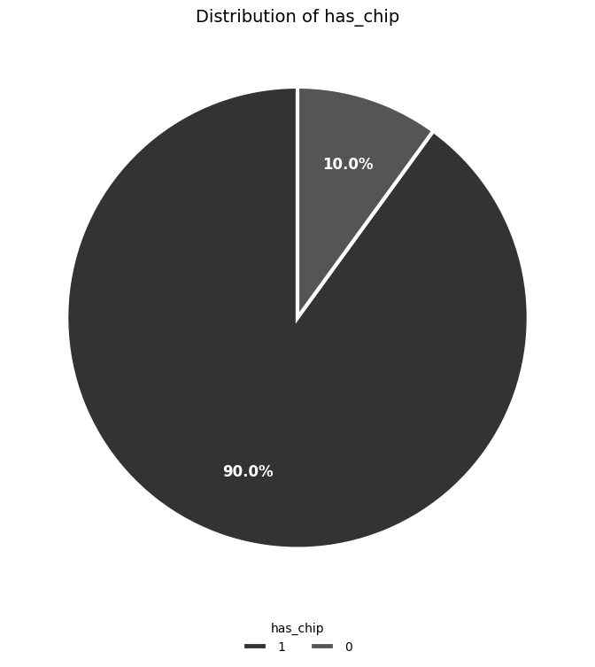
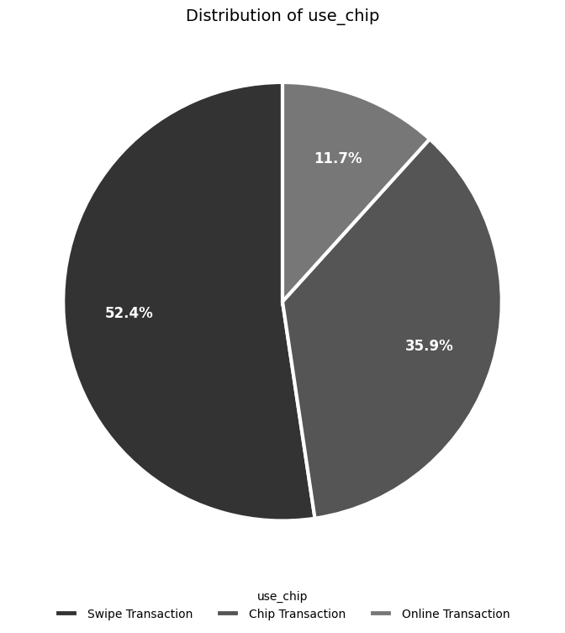
2.2 Data Exploration
Categorical Variables—Chip
Has Chip | Frequency
Yes (1) | 11,974,795 (90.00%)
No (0) | 1,331,120 (10.00%)
Use Chip | Frequency
Swipe Transaction | 6,967,185 (52.36%)
Chip Transaction | 4,780,818 (35.93%)
Online Transaction | 1,557,912 (11.71%)
Integrating Data-Level Balancing and Enhanced RFM-Based Feature engineering for Credit Card Fraud Detection

Slide 12
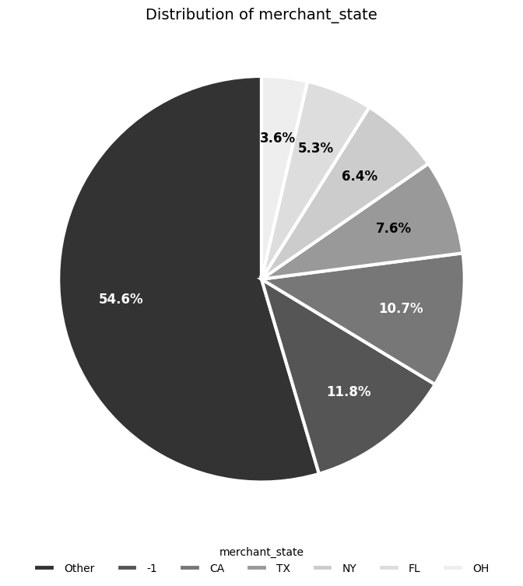
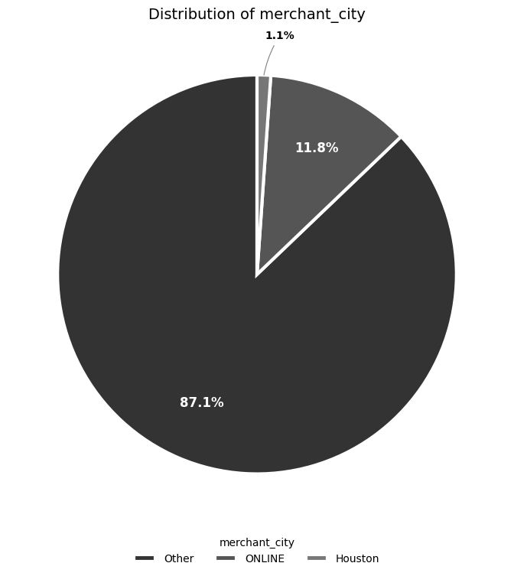
2.2 Data Exploration
Categorical Variables—Merchant Location/Online
Merchant State | Frequency
Online | 1,563,700 (11.75%)
CA | 1,427,087 (10.73%)
TX | 1,010,207 (7.59%)
NY | 857,510 (6.44%)
Merchant City | Frequency
Online | 1,563,700 (11.75%)
Houston | 146,917 (1.10%)
Miami | 87,388 (0.66%)
Brooklyn | 84,020 (0.63%)
Integrating Data-Level Balancing and Enhanced RFM-Based Feature engineering for Credit Card Fraud Detection

Slide 13
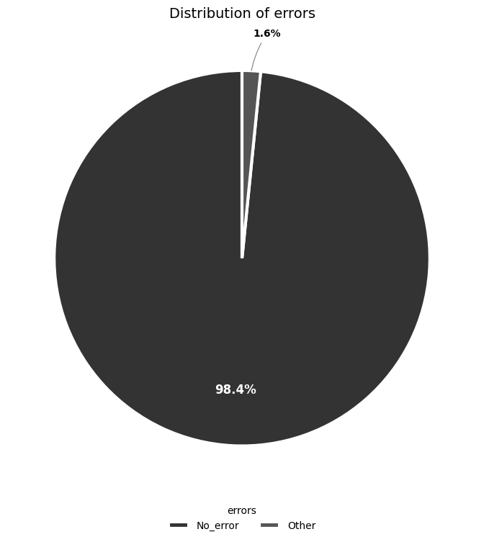
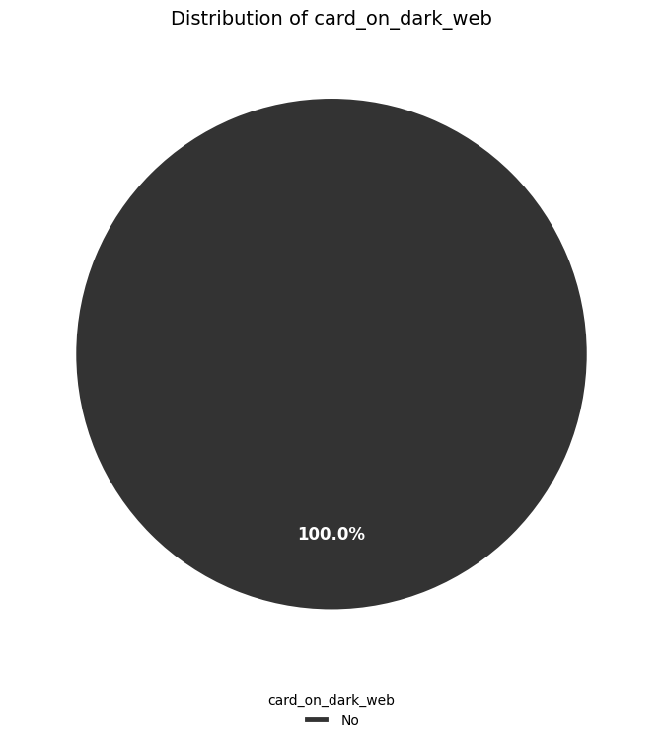
2.2 Data Exploration
Categorical Variables—Abnormal Transaction
Errors | Frequency
No Error | 13,094,522 (98.41%)
Insufficient Balance | 130,902 (0.98%)
Bad Pin | 32,119 (0.24%)
Technical Glitch | 26,271 (0.20%)
Card on Dark Web | Frequency
No (0) | 13,305,915 (100%)
Yes (1) | 0 (0%)
Integrating Data-Level Balancing and Enhanced RFM-Based Feature engineering for Credit Card Fraud Detection

Slide 14
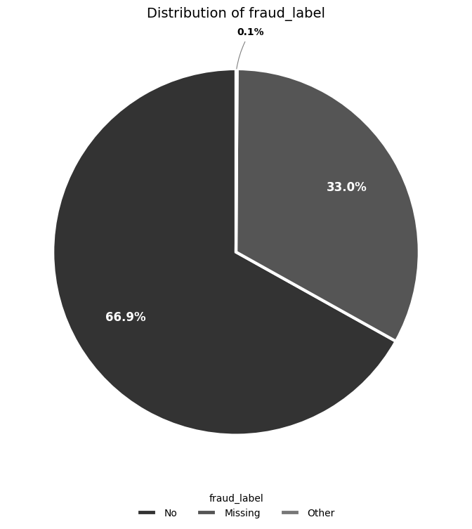
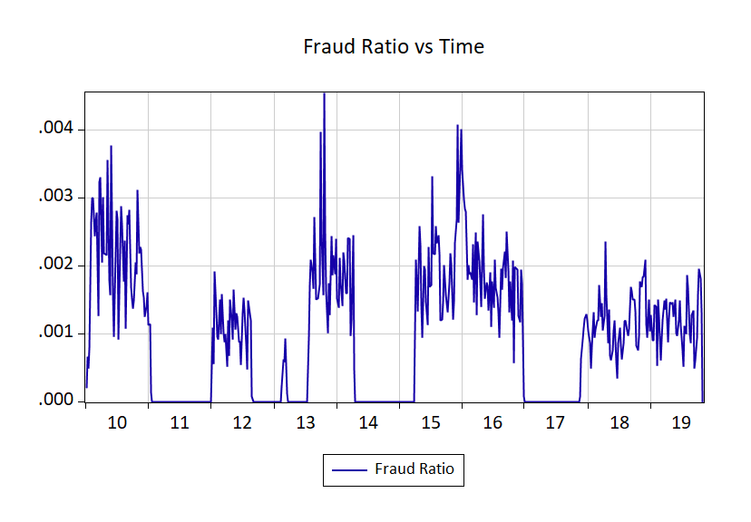
2.2 Data Exploration
Categorical Variables—Fraud Label
Fraud Label | Frequency
No | 8,901,631 (66.90%)
Missing | 4,390,952 (33.00%)
yes | 13,332 (0.10%)
Fraud w/o Missing | Frequency
No | 8,901,631 (99.85%)
Yes | 13,332 (0.15%)
Integrating Data-Level Balancing and Enhanced RFM-Based Feature engineering for Credit Card Fraud Detection

Slide 15
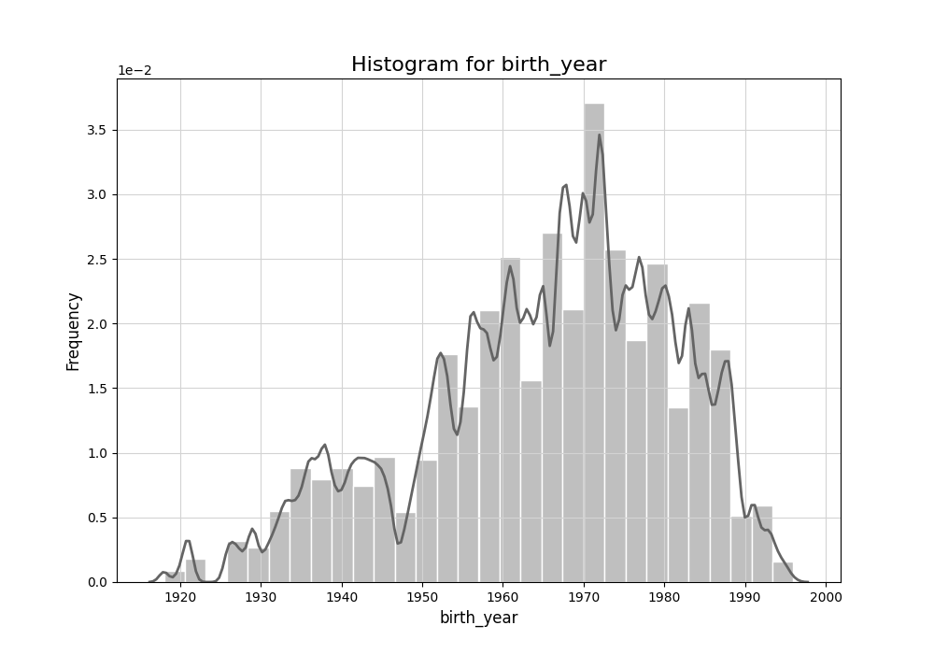
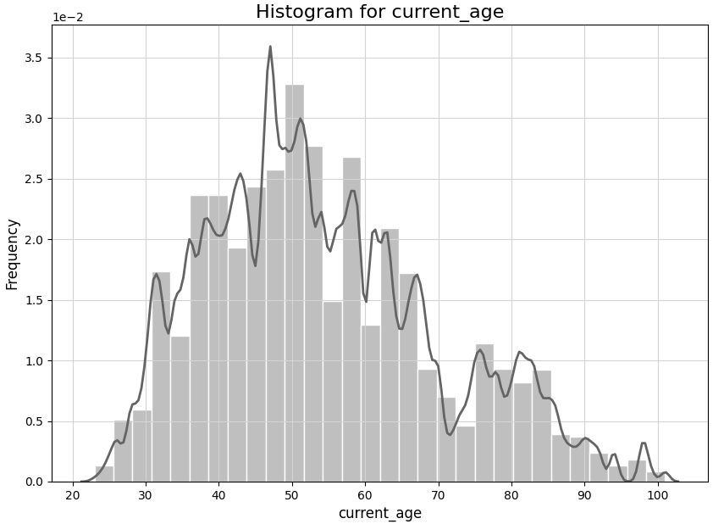
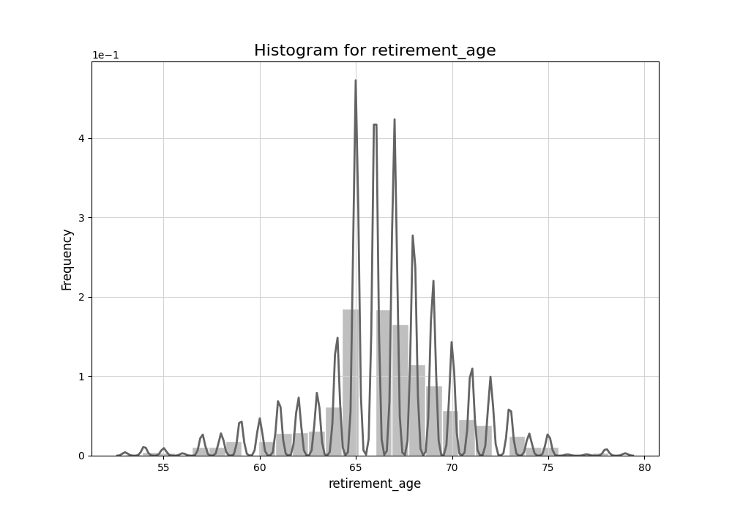
2.2 Data Exploration
Continuous Variables—Client Age
Statistics | birth_year | current_age | retirement_age
count | 13,305,915 | 13,305,915 | 13,305,915
mean | 1965.16 | 54.03 | 66.49
std | 15.72 | 15.73 | 3.59
min | 1918 | 23 | 53
25% | 1956 | 42 | 65
50% | 1968 | 52 | 66
75% | 1977 | 63 | 68
max | 1996 | 101 | 79
skewness | -0.55 | 0.55 | -0.32
kurtosis | -0.27 | -0.28 | 1.38
Integrating Data-Level Balancing and Enhanced RFM-Based Feature engineering for Credit Card Fraud Detection

Slide 16
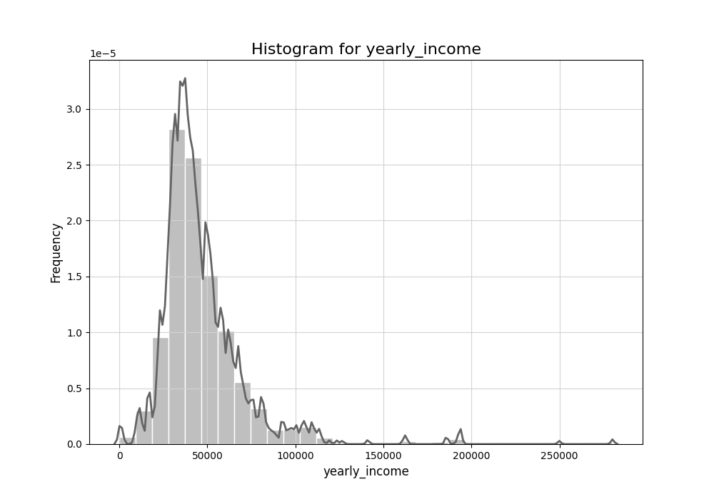
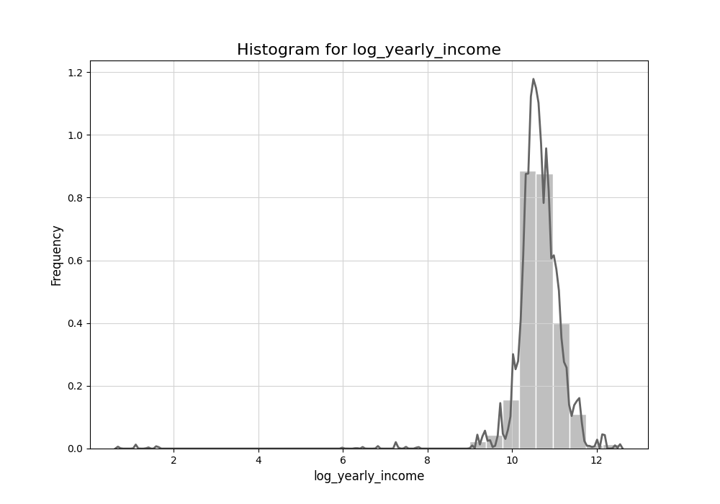
2.2 Data Exploration
Continuous Variables—Income
Statistics | yearly_income | log_yearly_income
count | 13,305,915 | 13,305,915
mean | 46,683.69 | 10.63
std | 24,445.09 | 0.65
min | 1 | 0.69
25% | 32,817 | 10.40
50% | 41,069 | 10.62
75% | 54,013 | 10.90
max | 280,199 | 12.54
skewness | 3.11 | -7.16
kurtosis | 18.07 | 98.51
Integrating Data-Level Balancing and Enhanced RFM-Based Feature engineering for Credit Card Fraud Detection

Slide 17
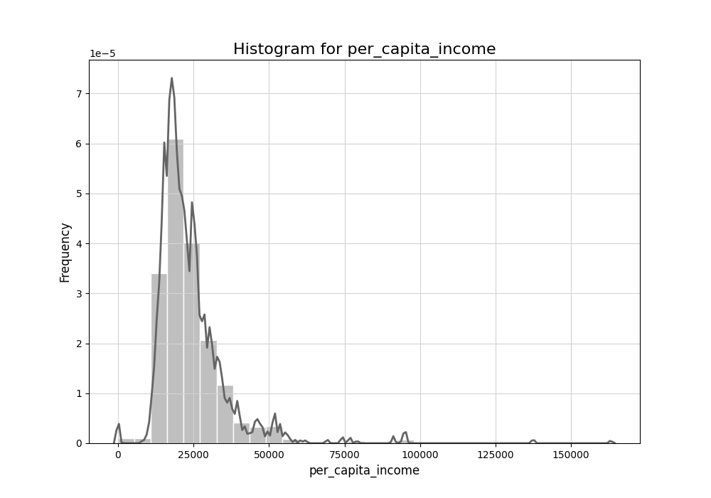
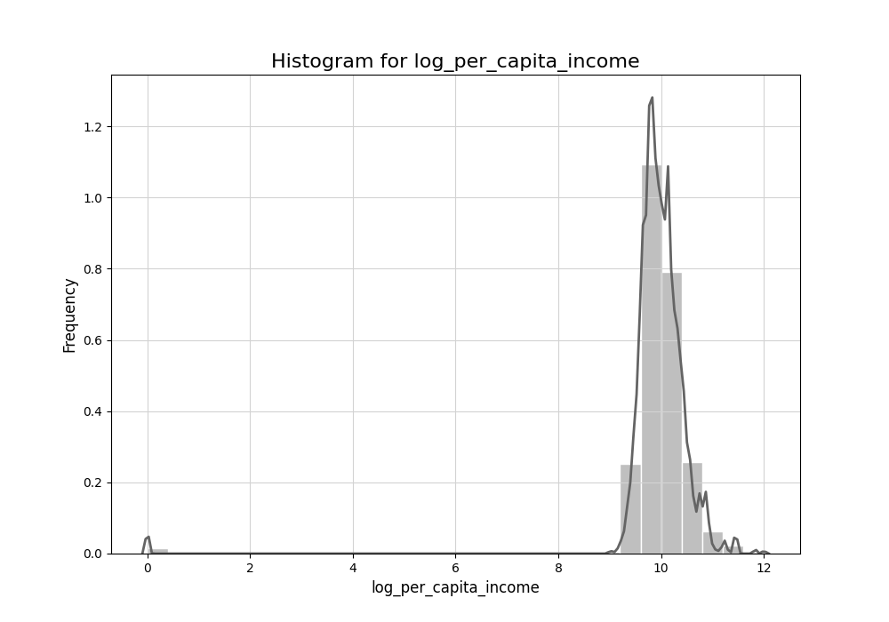
2.2 Data Exploration
Continuous Variables—Income
Statistics | per_capita_income | log_per_capita_income
count | 13,305,915 | 13,305,915
mean | 23,979.65 | 9.96
std | 11,967.12 | 0.83
min | 0 | 0
25% | 17,113 | 9.75
50% | 21,156 | 9.96
75% | 27,308 | 10.21
max | 163,145 | 12.00
skewness | 3.72 | -9.38
kurtosis | 26.21 | 110.55
Integrating Data-Level Balancing and Enhanced RFM-Based Feature engineering for Credit Card Fraud Detection

Slide 18
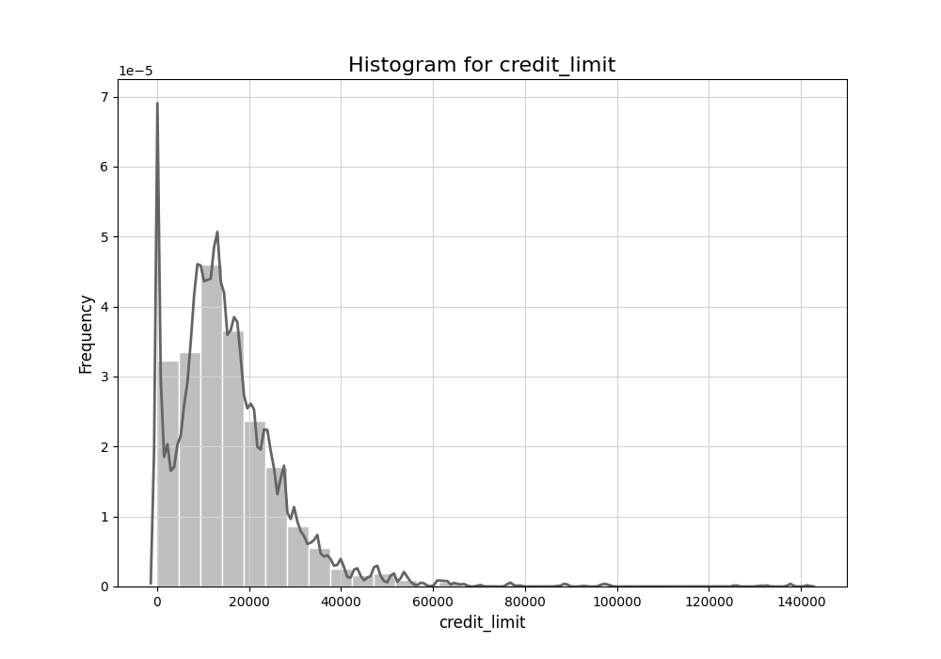
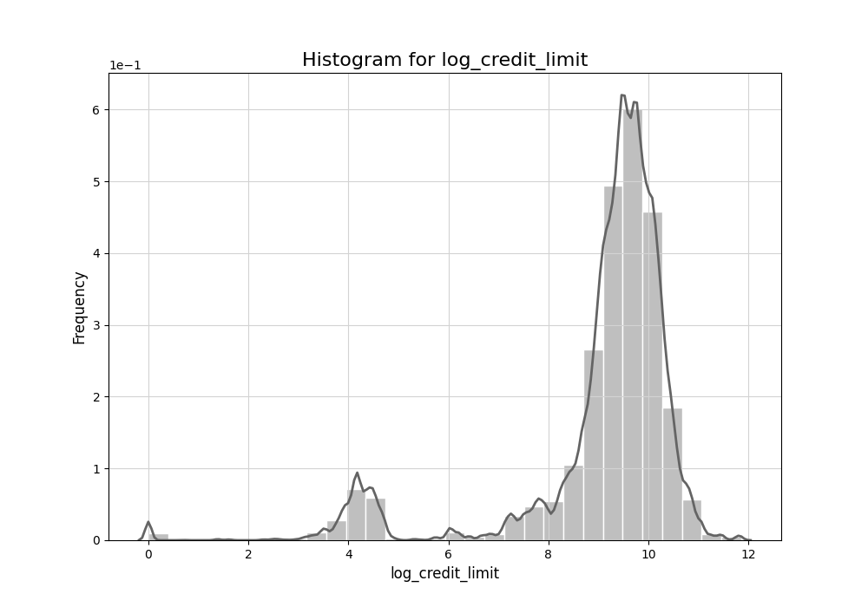
2.2 Data Exploration
Continuous Variables—Credit Limit
Statistics | credit_limit | log_credit_limit
count | 13,305,915 | 13,305,915
mean | 15,549.83 | 9.08
std | 12,181.06 | 1.66
min | 0 | 0
25% | 8,100 | 9.00
50% | 13,455 | 9.51
75% | 20,839 | 9.94
max | 141,391 | 11.86
skewness | 2.42 | -2.49
kurtosis | 14.52 | 6.61
Integrating Data-Level Balancing and Enhanced RFM-Based Feature engineering for Credit Card Fraud Detection

Slide 19
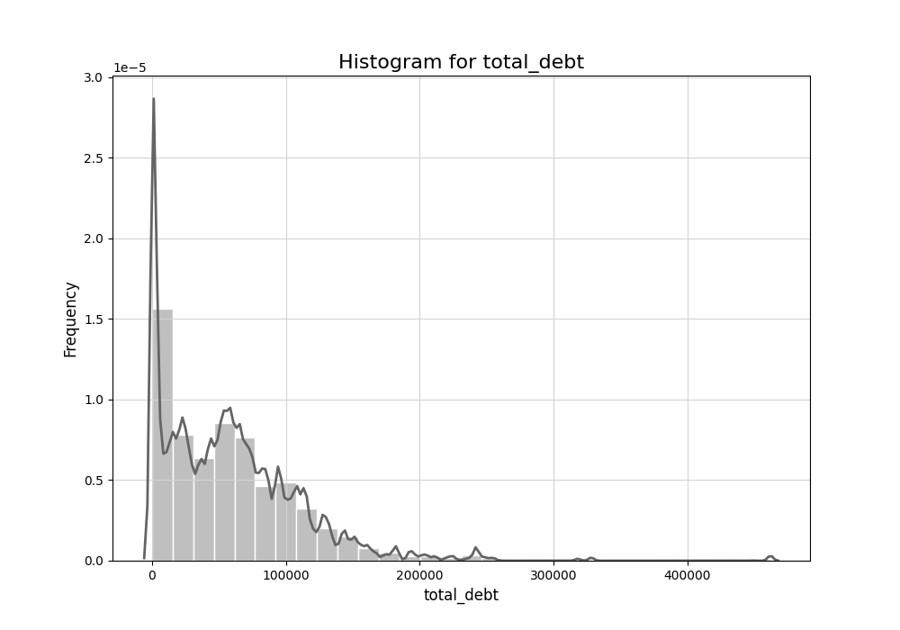
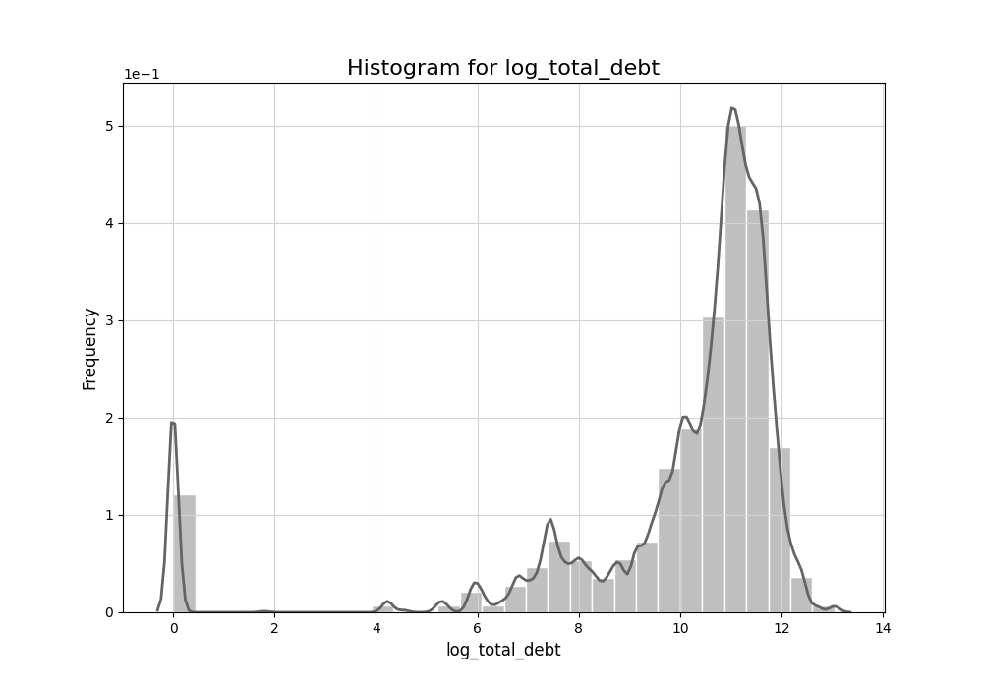
2.3 Cross-sectional Data
Continuous Variables—Debt
Statistics | total_debt | log_total_debt
count | 13,305,915 | 13,305,915
mean | 58,022.07 | 9.88
std | 52,100.96 | 2.73
min | 0 | 0
25% | 16,437 | 9.71
50% | 51,679 | 10.85
75% | 85,160 | 11.35
max | 461,854 | 13.04
skewness | 1.74 | -2.56
kurtosis | 7.05 | 6.39
Integrating Data-Level Balancing and Enhanced RFM-Based Feature engineering for Credit Card Fraud Detection

Slide 20
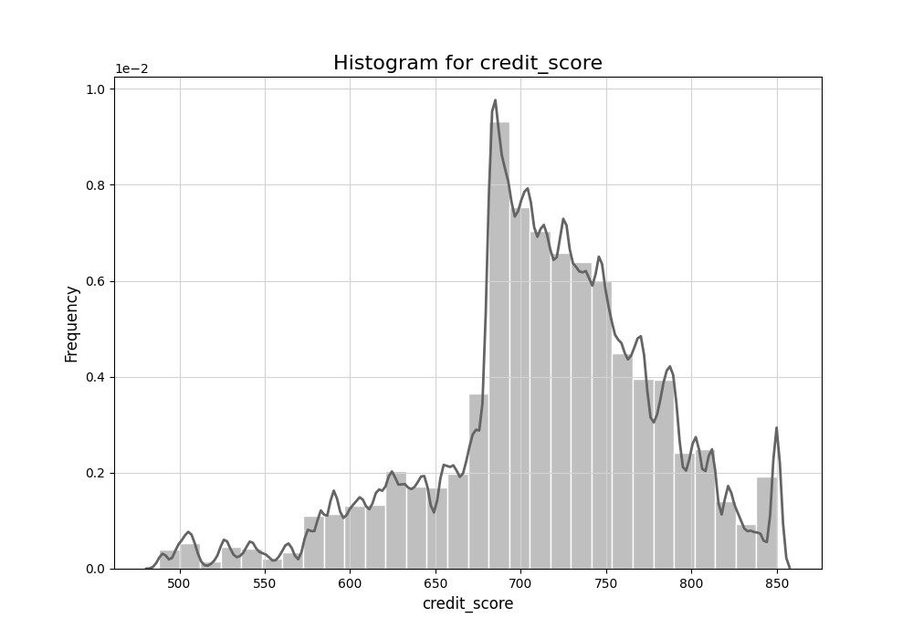
2.3 Cross-sectional Data
Continuous Variables—Credit Score
Statistics | credit_score
count | 13,305,915
mean | 713.91
std | 65.80
min | 488
25% | 684
50% | 716
75% | 756
max | 850
skewness | -0.60
kurtosis | 0.82
Integrating Data-Level Balancing and Enhanced RFM-Based Feature engineering for Credit Card Fraud Detection

Slide 21
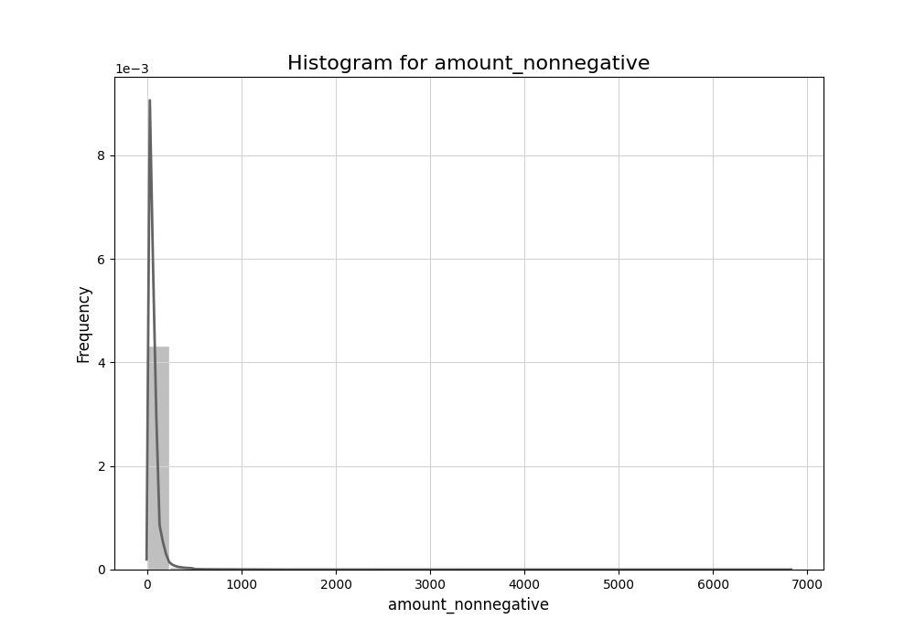
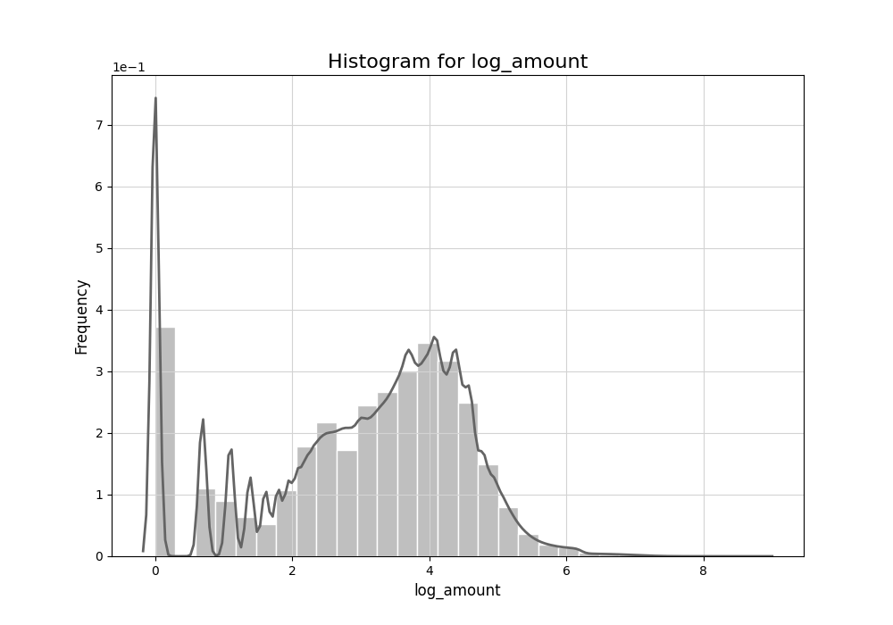
2.3 Cross-sectional Data
Continuous Variables—Amount
Statistics | amount/amount_nonnegative | log_amount*
count | 13,305,915 | 13,305,915
mean | 42.55/47.70 | 3.00
std | 81.64/72.97 | 1.54
min | -500/1 | 0
25% | 8 | 2.08
50% | 28 | 3.33
75% | 63 | 4.14
max | 6,820 | 8.83
skewness | 5.27/8.13 | -0.58
kurtosis | 111.28/168.48 | -0.49
Integrating Data-Level Balancing and Enhanced RFM-Based Feature engineering for Credit Card Fraud Detection

Slide 22

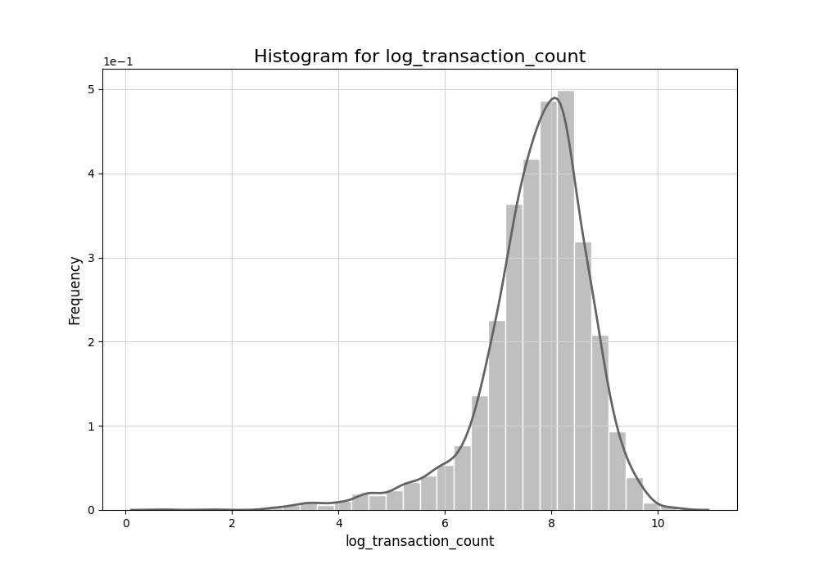
2.3 Cross-sectional Data
Continuous Variables—Transaction Frequency*
Statistics | transaction_count | log_transaction_count
count | 4,071 | 4,071
mean | 3,268.46 | 7.70
std | 2,866.22 | 1.03
min | 1 | 0.69
25% | 1,419 | 7.26
50% | 2,558 | 7.85
75% | 4,166.5 | 8.34
max | 31,552 | 10.36
skewness | 2.58 | -1.34
kurtosis | 12.59 | 3.47
Integrating Data-Level Balancing and Enhanced RFM-Based Feature engineering for Credit Card Fraud Detection

Slide 23
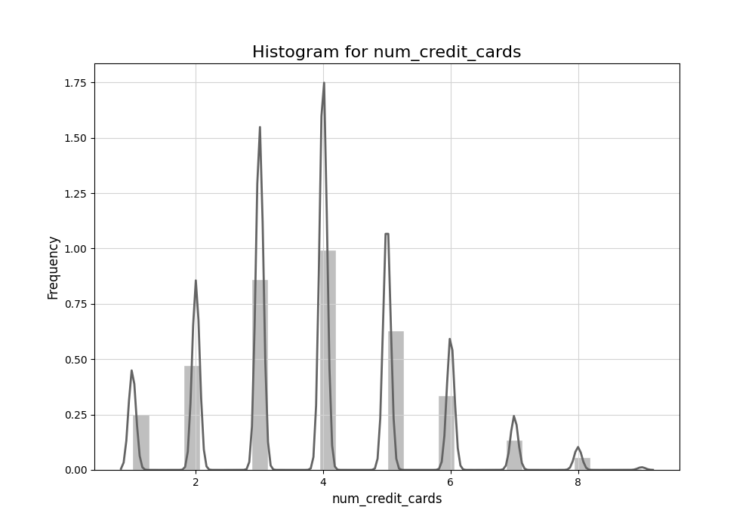
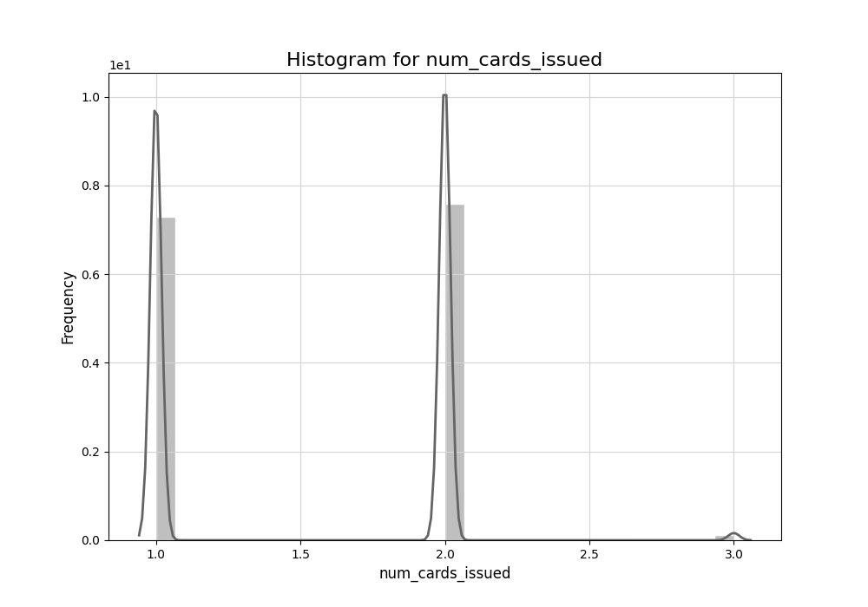
2.3 Cross-sectional Data
Continuous Variables—Number of Cards
Statistics | num_credit_cards* | num_card_issued
count | 13,305,915 | 13,305,915
mean | 3.84 | 1.52
std | 1.57 | 0.52
min | 1 | 1
25% | 3 | 1
50% | 4 | 2
75% | 5 | 2
max | 9 | 3
skewness | 0.31 | 0.08
kurtosis | -0.08 | -1.57
Integrating Data-Level Balancing and Enhanced RFM-Based Feature engineering for Credit Card Fraud Detection

Slide 24
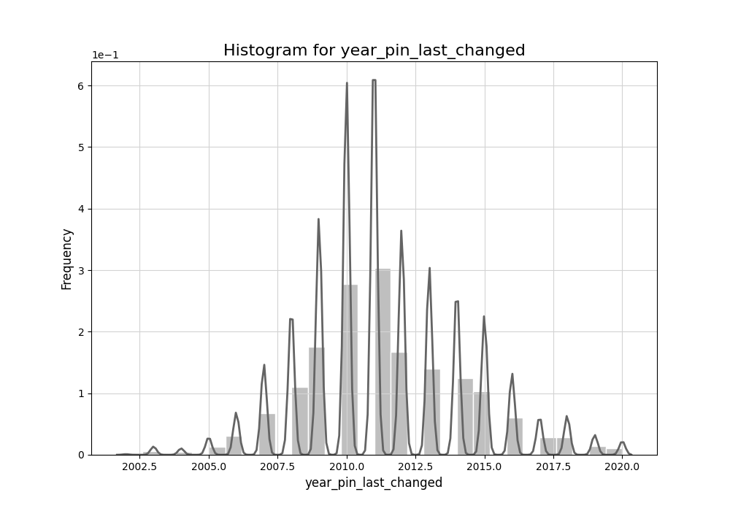
2.3 Cross-sectional Data
Continuous Variables—Year Pin
Statistics | year_pin_last_changed
count | 13,305,915
mean | 2,011.34
std | 2.89
min | 2002
25% | 2010
50% | 2011
75% | 2013
max | 2020
skewness | 0.36
kurtosis | 0.29
Integrating Data-Level Balancing and Enhanced RFM-Based Feature engineering for Credit Card Fraud Detection

Slide 25
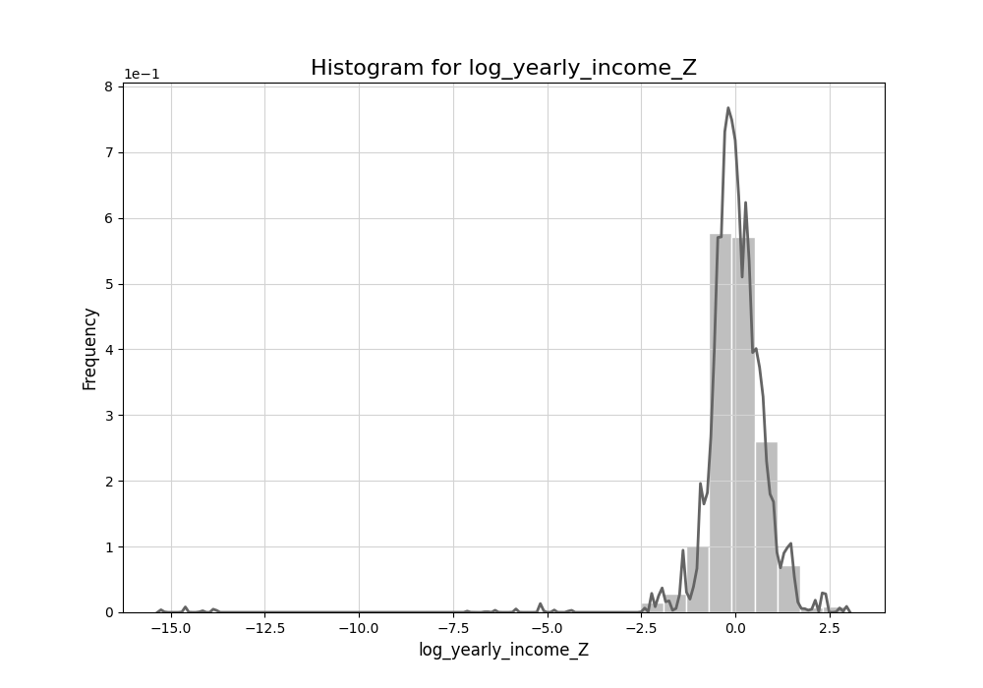
2.3 Cross-sectional Data
Scaling–Z score for Logarithm Variable
Original Variable | Logarithmic Variables | Scaled Variable | Reason
amount | log_amount | log_amount_Z | log transformation
yearly_income | log_yearly_income | log_yearly_income_Z
per_capita_income | log_per_capita_income | log_per_capita_income_Z
credit_limit | log_credit_limit | log_credit_limit_Z
total_debt | log_total_debt | log_total_debt_Z
Integrating Data-Level Balancing and Enhanced RFM-Based Feature engineering for Credit Card Fraud Detection

Slide 26
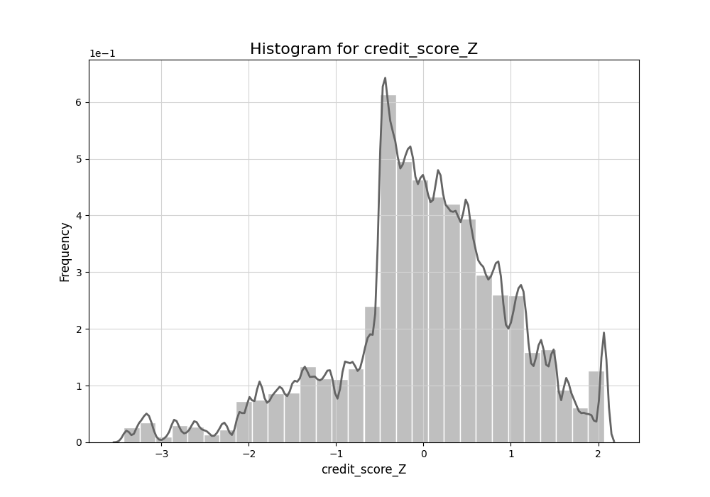
2.3 Cross-sectional Data
Scaling–Z score
Variable | Scaled Variable | Reason
credit_score | credit_score_Z | highly bounded (Min 488.00, Max 850.00), close to normal, slightly left-skewed
current_age | current_age_Z | continuous, bounded variables, multimodal
retirement_age | retirement_age_Z
Integrating Data-Level Balancing and Enhanced RFM-Based Feature engineering for Credit Card Fraud Detection

Slide 27

2.3 Cross-sectional Data
Scaling–Min-Max Scaling
Variable | Reason
num_credit_cards | ordinal, discrete, limited ranged (Min 1.00, Max 9.00)
num_cards_issued | extremely tightly bounded (Min 1.00, Max 3.00)
Integrating Data-Level Balancing and Enhanced RFM-Based Feature engineering for Credit Card Fraud Detection

Slide 28
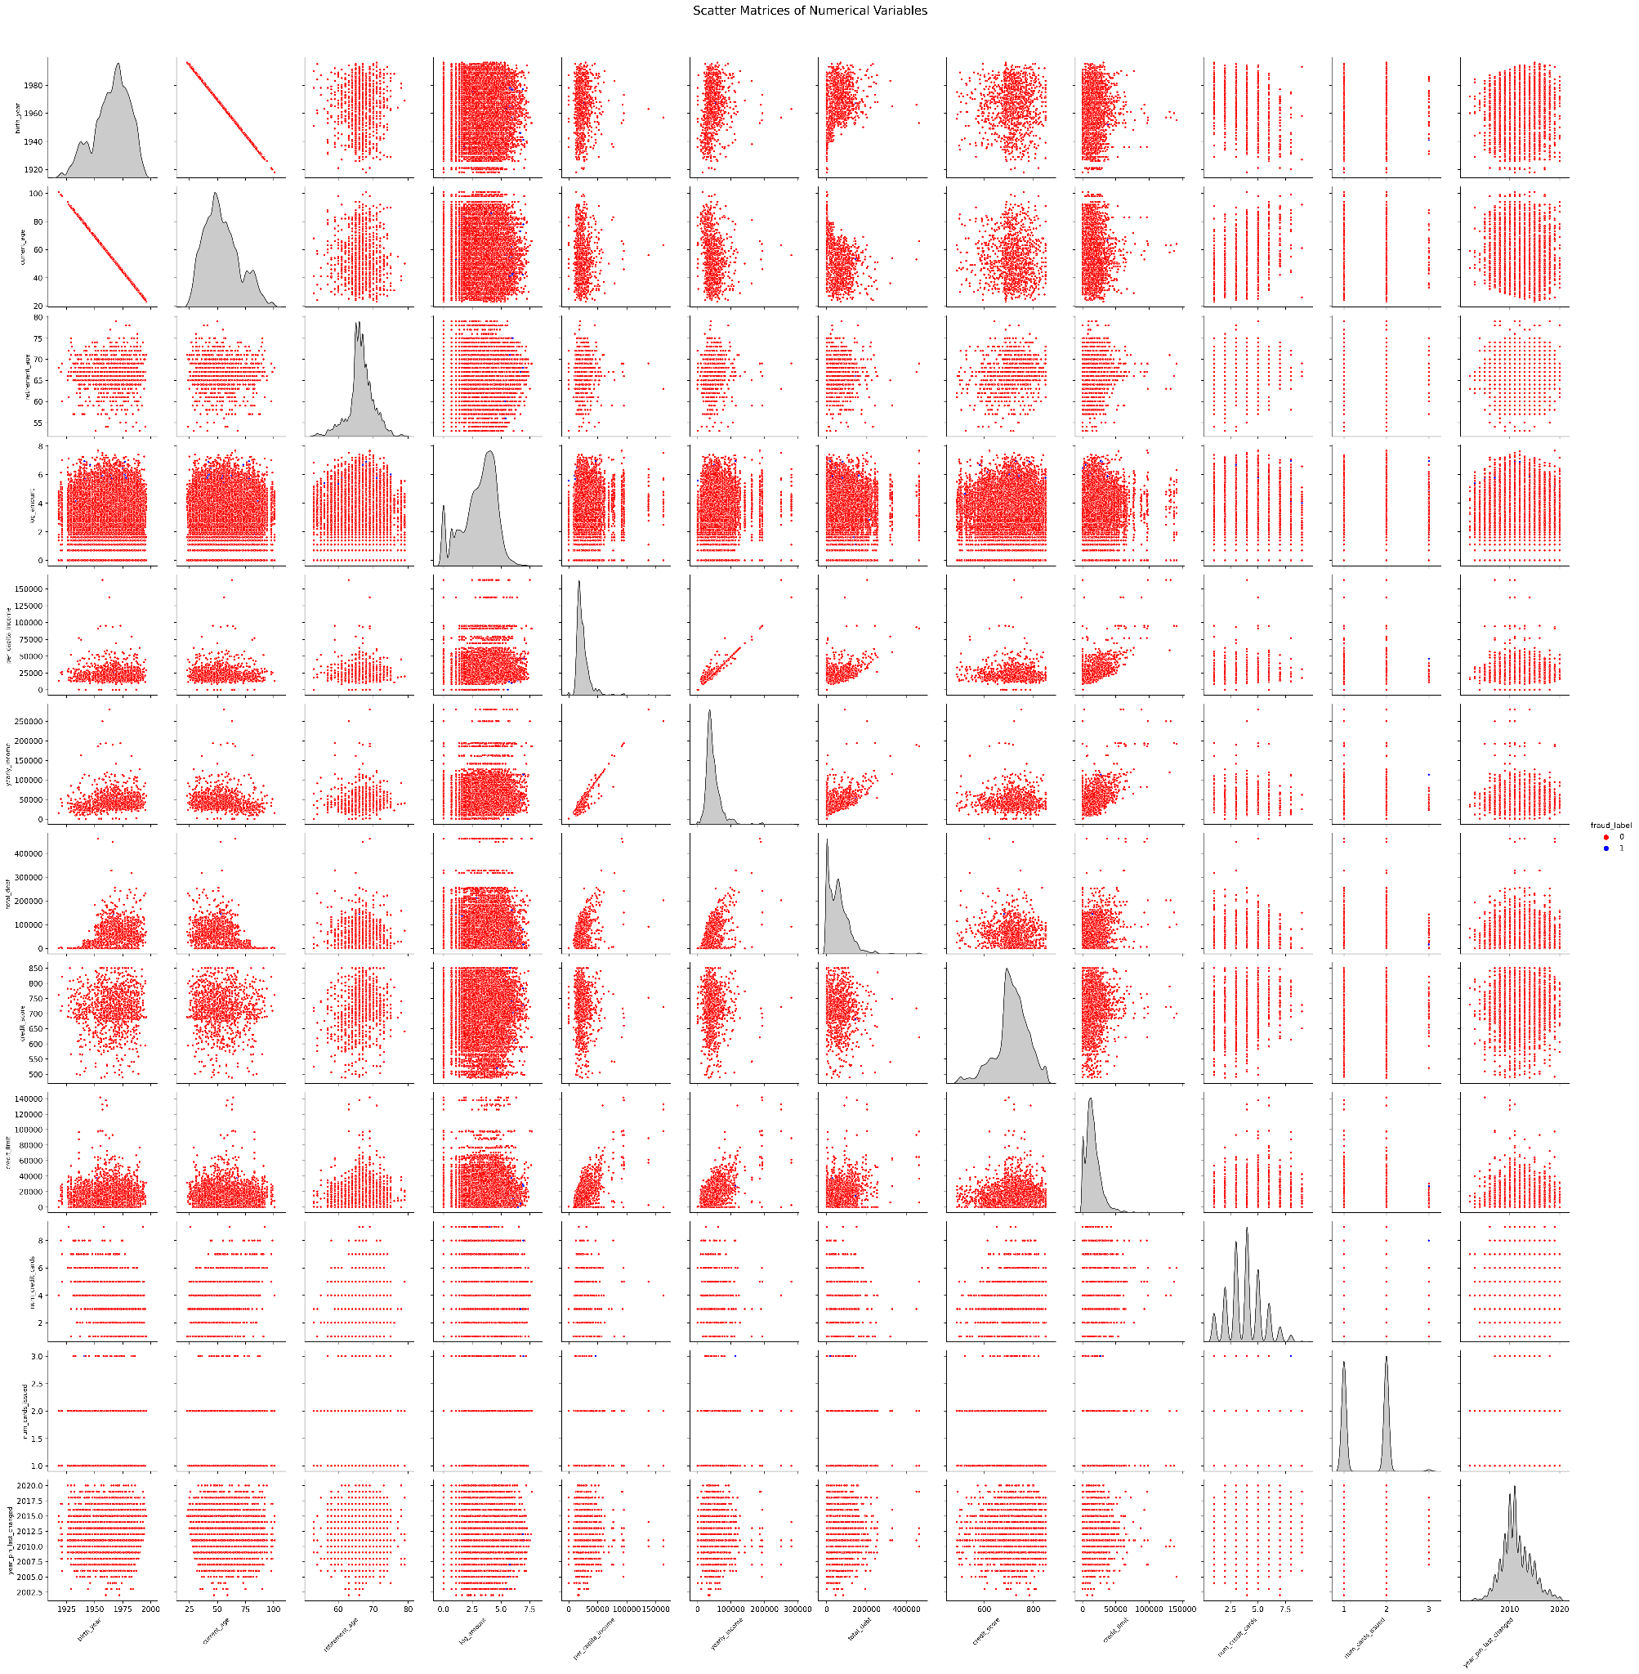
2.3 Cross-sectional Data
Correlation–Scatter Matrix
Integrating Data-Level Balancing and Enhanced RFM-Based Feature engineering for Credit Card Fraud Detection

Slide 29
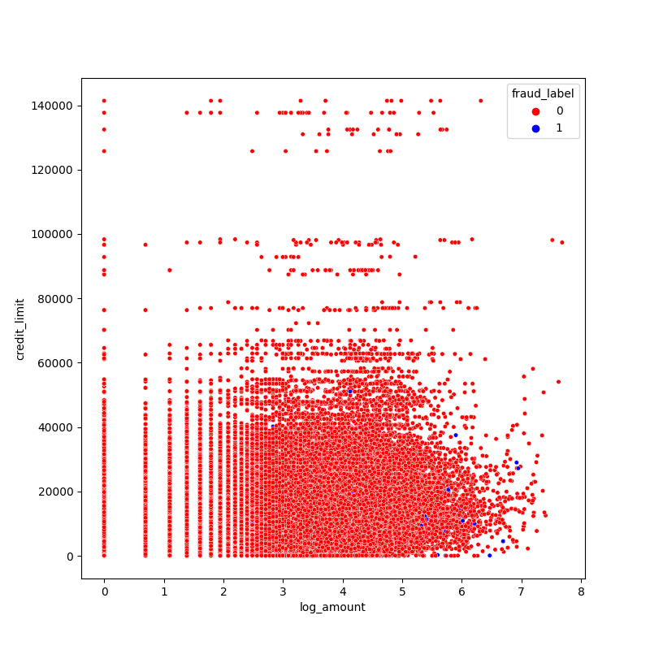
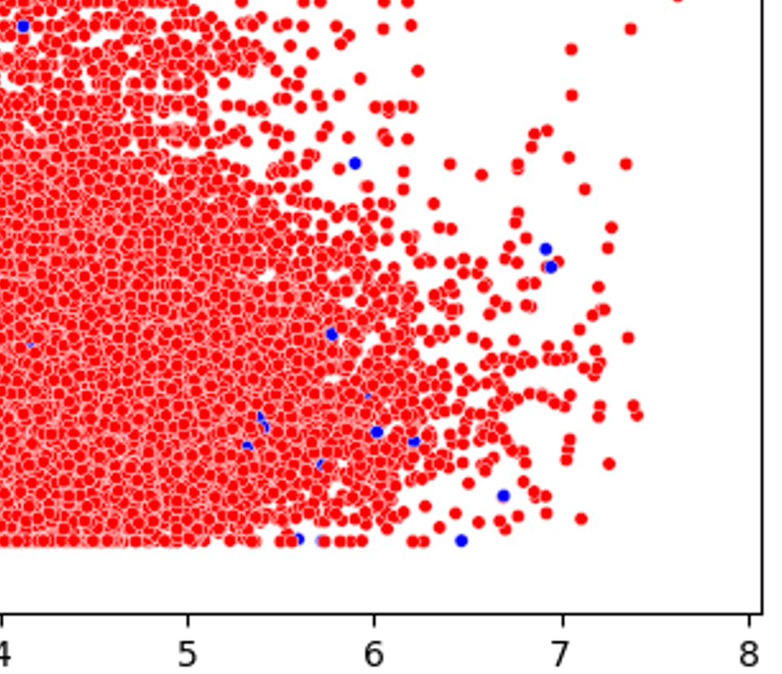
2.3 Cross-sectional Data
Correlation–Key Finding in Scatter Matrix
What’s Special?
Potential Pattern of Fraudulent Data?
High Amount
Low Credit Limit
High in Credit Card Number
High in Number of Issued Cards
Integrating Data-Level Balancing and Enhanced RFM-Based Feature engineering for Credit Card Fraud Detection

Slide 30
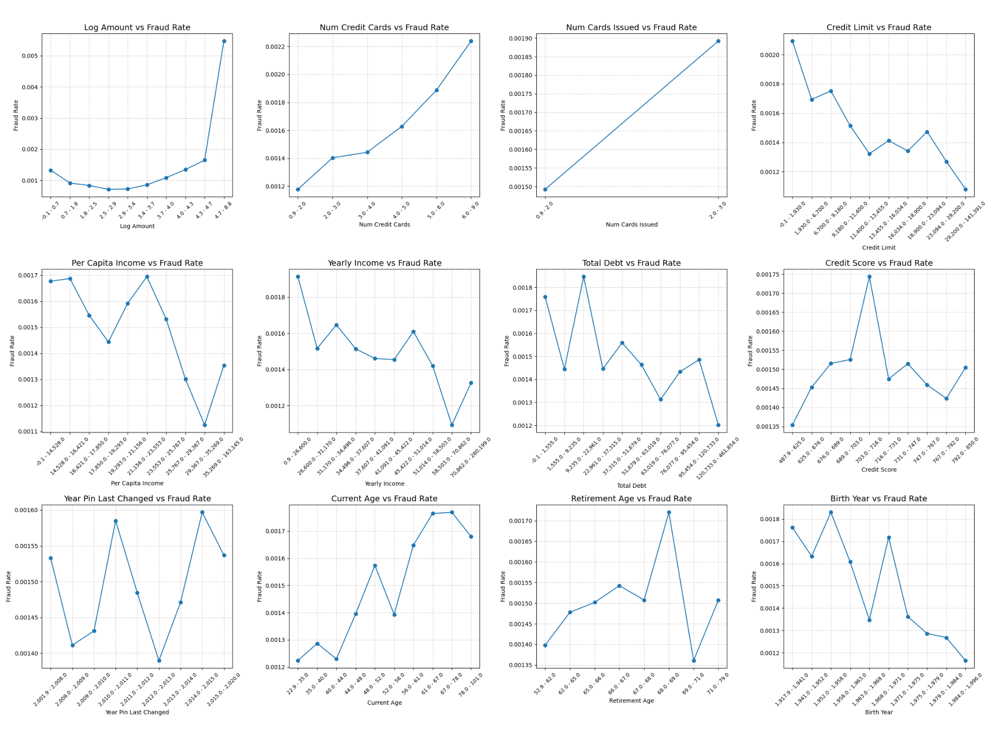
2.3 Cross-sectional Data
Correlation–Key Finding in Scatter Matrix
Integrating Data-Level Balancing and Enhanced RFM-Based Feature engineering for Credit Card Fraud Detection

Slide 31
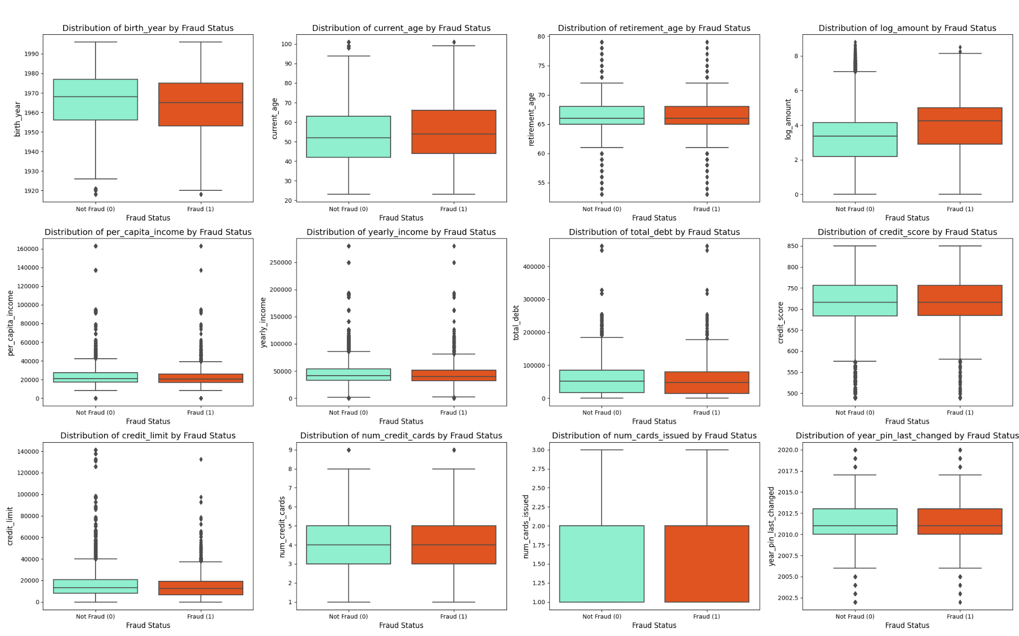
2.3 Cross-sectional Data
Correlation–Bivariate Box Plot
Integrating Data-Level Balancing and Enhanced RFM-Based Feature engineering for Credit Card Fraud Detection

Slide 32
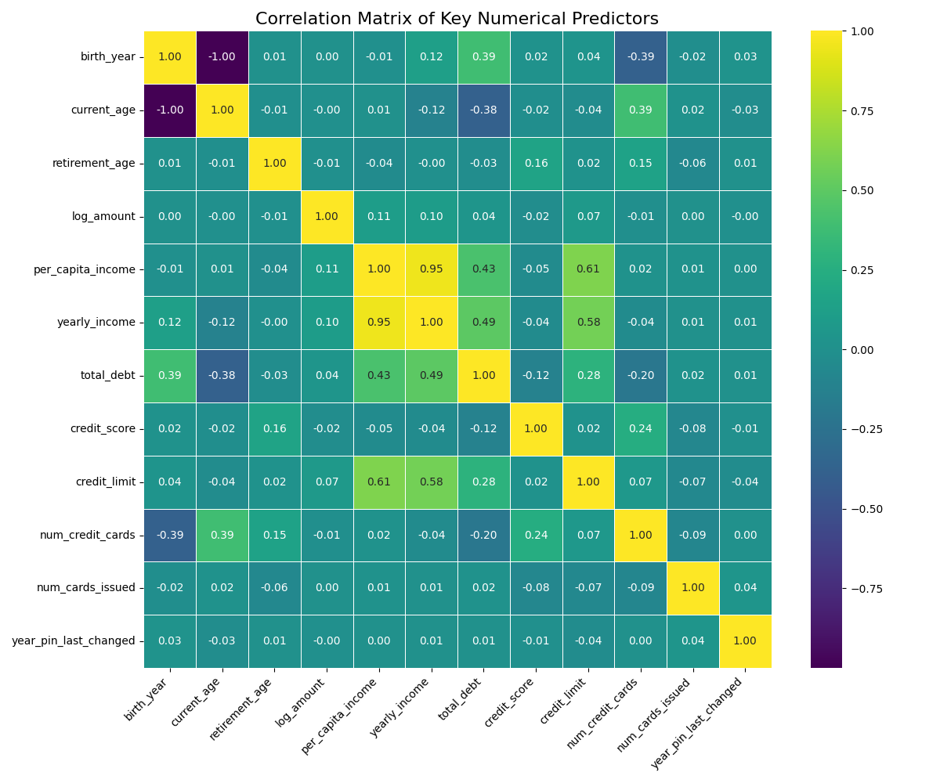
2.3 Cross-sectional Data
Correlation–Scatter Matrix
Integrating Data-Level Balancing and Enhanced RFM-Based Feature engineering for Credit Card Fraud Detection

Slide 33
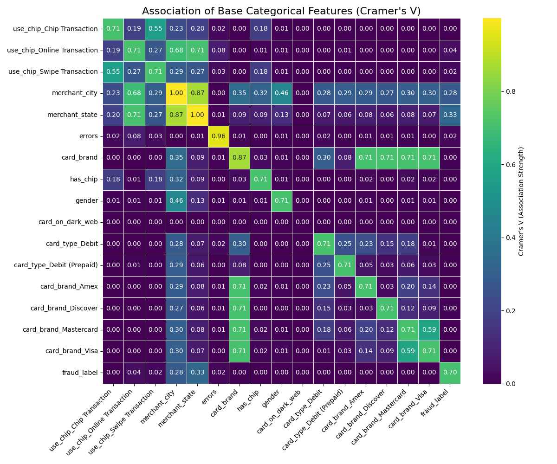
2.3 Cross-sectional Data
Correlation–Scatter Matrix
Integrating Data-Level Balancing and Enhanced RFM-Based Feature engineering for Credit Card Fraud Detection

Slide 34
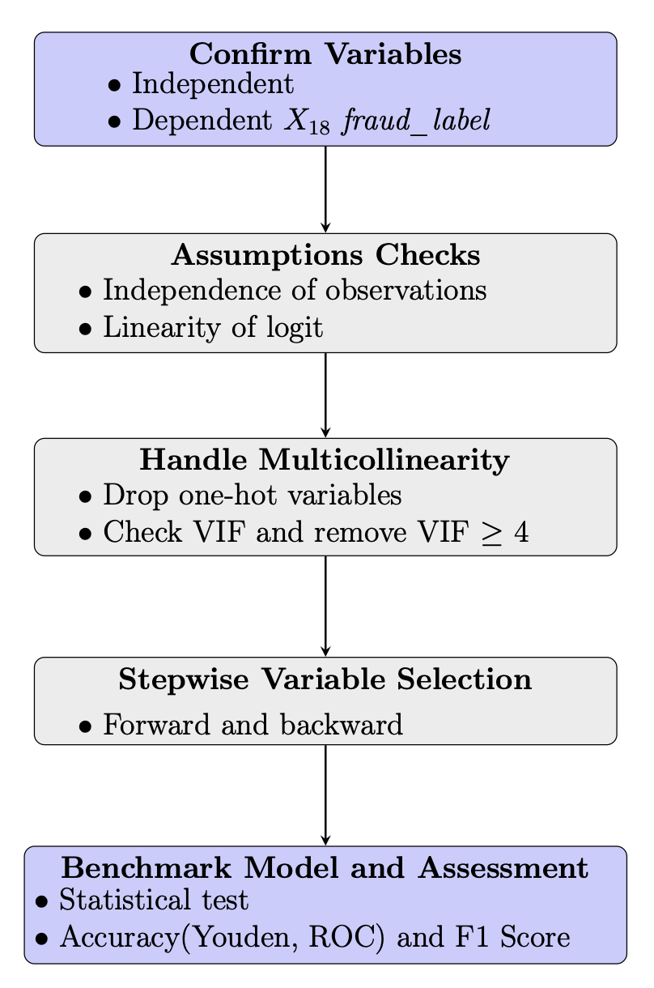
3 Methodology
For benchmark model
Aim: handle binary classification issue
Modeling the Logistic Regression
numeric/ categorical variables
assumptions
estimation
Logistic Regression Assessment
Compare the Accuracy and F1 Score
Integrating Data-Level Balancing and Enhanced RFM-Based Feature engineering for Credit Card Fraud Detection

Slide 35
3.1 Benchmark model
About Logistic Regression
Binary classification issue
Few assumptions
Independence of observations
Linearity of logit (Ignore)
Sample size (RULE of THUMB) More than 400, 100 times of independents variables(29)
Training set: 7,131,970
Testing set: 1,782,994
Integrating Data-Level Balancing and Enhanced RFM-Based Feature engineering for Credit Card Fraud Detection

Slide 36
3.1 Benchmark model – Logistic Regression
Benchmark Model—Logistic Regression
Linearity of logit assumption– check Box Tidwell Test
Index | Variables | p-value | Result
X₅ | amount | 0.00E+00 | Violated
X₁₀ | zip | 3.95E-197 | Violated
X₁₁ | mcc_code | 4.86E-155 | Violated
X₁ | transaction_id | 2.69E-49 | Violated
X₇ | merchant_id | 7.49E-13 | Violated
X₂₀ | current_age | 8.55E-11 | Violated
X₂₁ | retirement_age | 3.01E-09 | Violated
X₃₅ | card_number | 5.35E-05 | Violated
X₄₀ | credit_limit | 5.78E-02 | Satisfied
X₃₁ | credit_score | 6.75E-02 | Satisfied
X₃₂ | num_credit_cards | 7.52E-02 | Satisfied
Integrating Data-Level Balancing and Enhanced RFM-Based Feature engineering for Credit Card Fraud Detection

Slide 37
3.1 Benchmark model – Logistic Regression
Benchmark Model—Logistic Regression
Multicollinearity assumption– check VIF index
Index | Variables | VIF Factor
X₂₆ | card_number | 22.243090
X₂₉ | card_brand_Amex | 4.419995
X₃₈ | zip | 2.302851
X₂₇ | longitude | 2.117485
X₂₈ | per_capita_income | 1.843738
X₁₆ | use_chip_Chip Transaction | 1.749374
X₁₈ | use_chip_Swipe Transaction | 1.718199
X₂₉ | yearly_income | 1.631605
X₃₀ | total_debt | 1.538366
X₁₄ | zip_missing_flag | 1.466621
Index | Variables | VIF Factor
X₃₈ | zip | 2.53292
X₂₇ | longitude | 2.460976
X₁₈ | use_chip_Swipe Transaction | 1.979256
X₁ | transaction_id | 1.768991
X₄₀ | credit_limit | 1.707588
X₂₉ | yearly_income | 1.627438
X₃₀ | total_debt | 1.592191
X₂₀ | current_age | 1.515529
X₄₅ | card_type_Debit | 1.414488
X₃₉ | num_credit_cards | 1.322601
Integrating Data-Level Balancing and Enhanced RFM-Based Feature engineering for Credit Card Fraud Detection

Slide 38
3.1 Benchmark model – Logistic Regression
Variables Selection guideline
Model Fit Evaluation: Use the −2 Log(Likelihood) value to assess overall model improvement.
Stepwise Selection Procedure: Iteratively add or remove variables based on statistical criteria.
Entry and Removal Criteria: Include variables with significant(p < 0.05) LR test(add)/Wald statistic(remove) ; remove non-significant ones.
Stopping Rule: Continue until no excluded variable produces a statistically significant improvement in model likelihood.
Goal: Achieve a parsimonious model — good fit with minimal predictors.
Hair, J. F., Black, W. C., Babin, B. J., & Anderson, R. E. (2019).
Multivariate Data Analysis (8th ed.). Cengage Learning.
Integrating Data-Level Balancing and Enhanced RFM-Based Feature engineering for Credit Card Fraud Detection

Slide 39
3.1 Benchmark model – Logistic Regression
Variables for Logistic Regression
Summary of variables
Index | Variables | Type | Index | Variables | Type
Y | Fraud_label | numeric | X₂₁ | retirement_age | numeric
X₁ | transaction_id | numeric | X₂₆ | latitude | numeric
X₃ | client_id | numeric | X₂₇ | longitude | numeric
X₅ | amount | numeric | X₂₉ | yearly_income | numeric
X₇ | merchant_id | numeric | X₃₁ | credit_score | numeric
X₁₀ | zip | numeric | X₃₂ | num_credit_cards | numeric
X₁₁ | mcc_code | numeric | X₃₈ | has_chip | category
X₁₅ | errors_missing_flag | category | X₄₀ | credit_limit | numeric
X₁₈ | use_chip_Swipe Transaction | category | X₄₉ | card_brand_Mastercard | category
Integrating Data-Level Balancing and Enhanced RFM-Based Feature engineering for Credit Card Fraud Detection

Slide 40
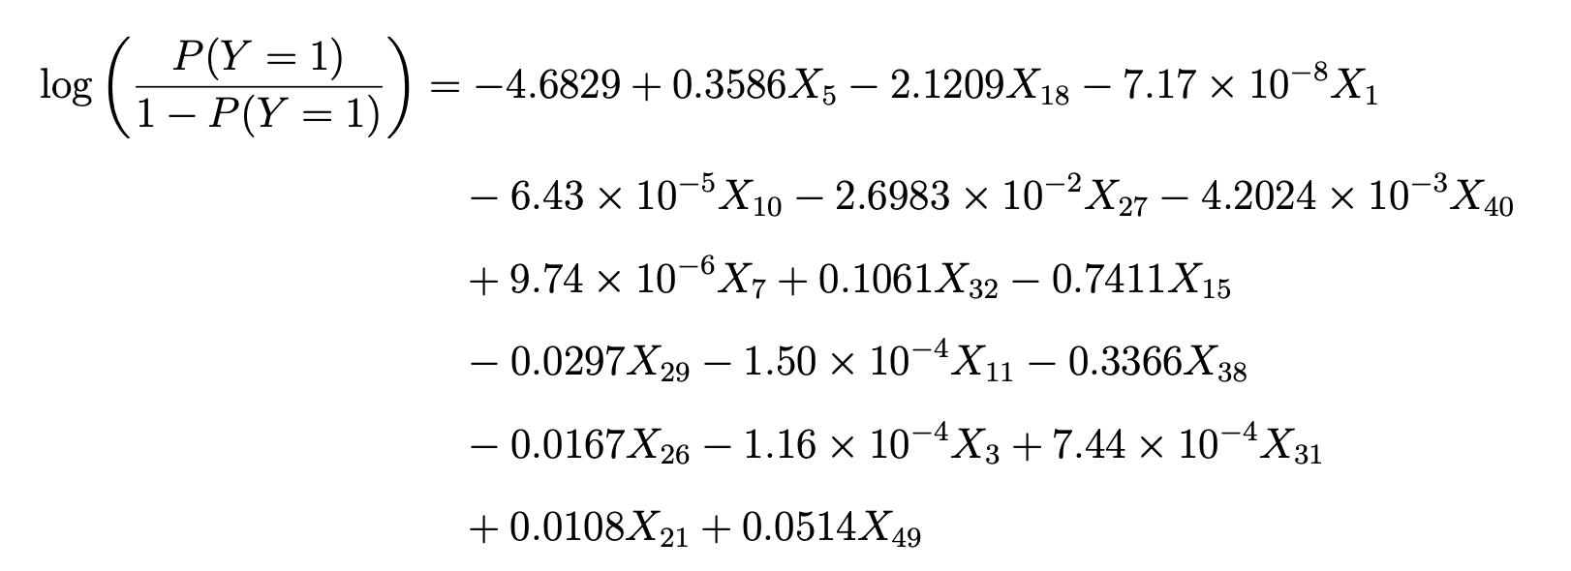
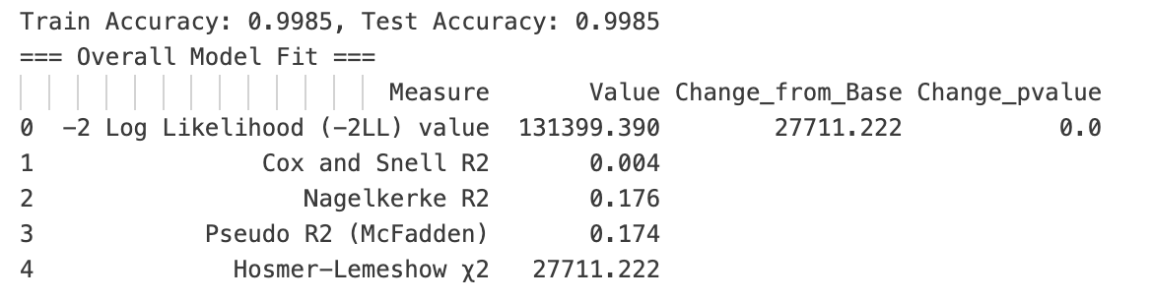
3.1 Benchmark model – Logistic Regression
Benchmark Model—Logistic Regression overall model fit
Stepwise completed until variables X₄₉ card_brand_Mastercard
Integrating Data-Level Balancing and Enhanced RFM-Based Feature engineering for Credit Card Fraud Detection

Slide 41
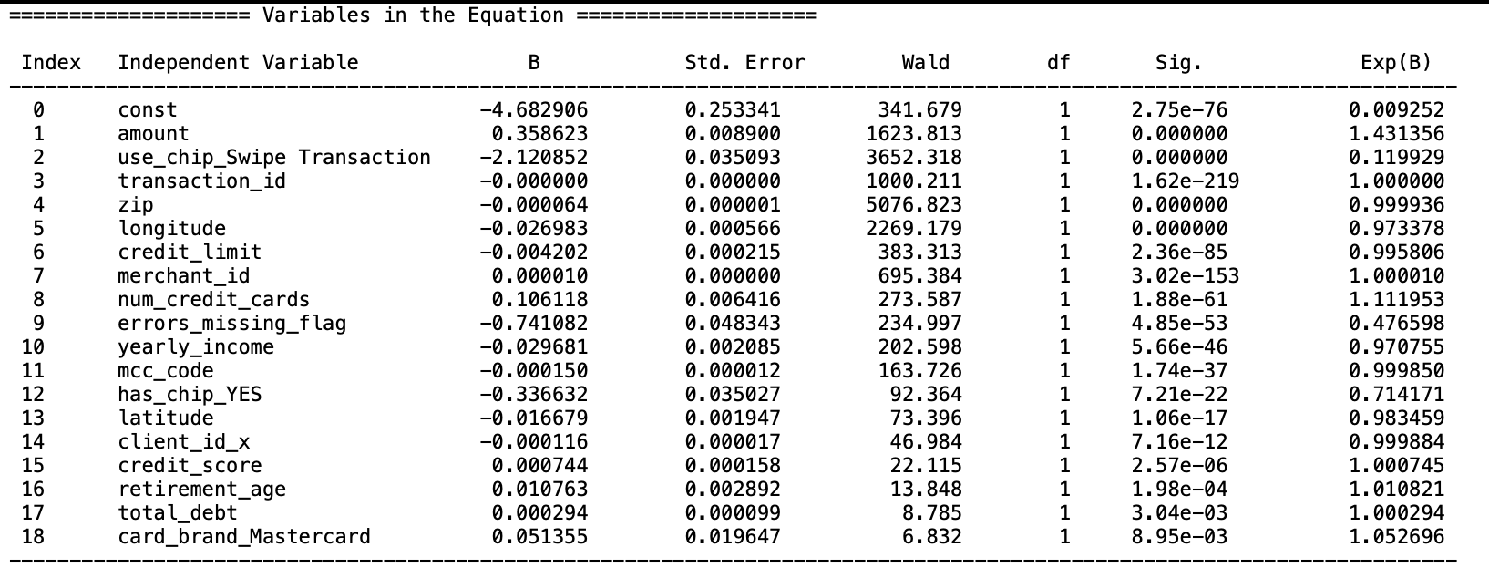
3.1 Benchmark model – Logistic Regression
Benchmark Model—Logistic Regression overall model fit
Stepwise completed until variables X₄₉ card_brand_Mastercard
Integrating Data-Level Balancing and Enhanced RFM-Based Feature engineering for Credit Card Fraud Detection

Slide 42
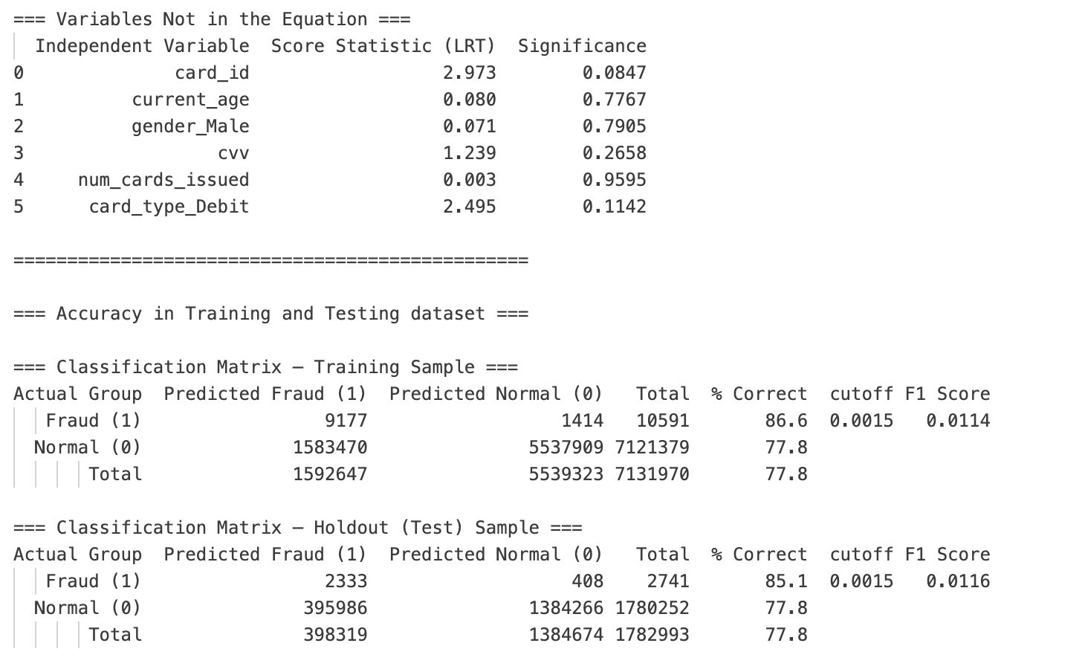
3.1 Benchmark model – Logistic Regression
Benchmark Model—Logistic Regression overall model fit
Stepwise completed until variables X₄₉ card_brand_Mastercard
Integrating Data-Level Balancing and Enhanced RFM-Based Feature engineering for Credit Card Fraud Detection

Slide 43
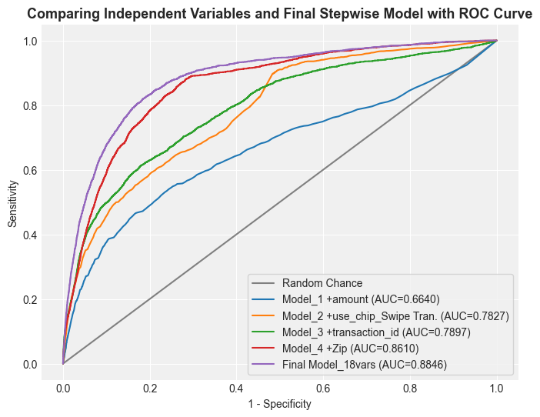
3.1 Benchmark model – Logistic Regression
Benchmark Model—Logistic Regression overall model fit
Integrating Data-Level Balancing and Enhanced RFM-Based Feature engineering for Credit Card Fraud Detection

Slide 44
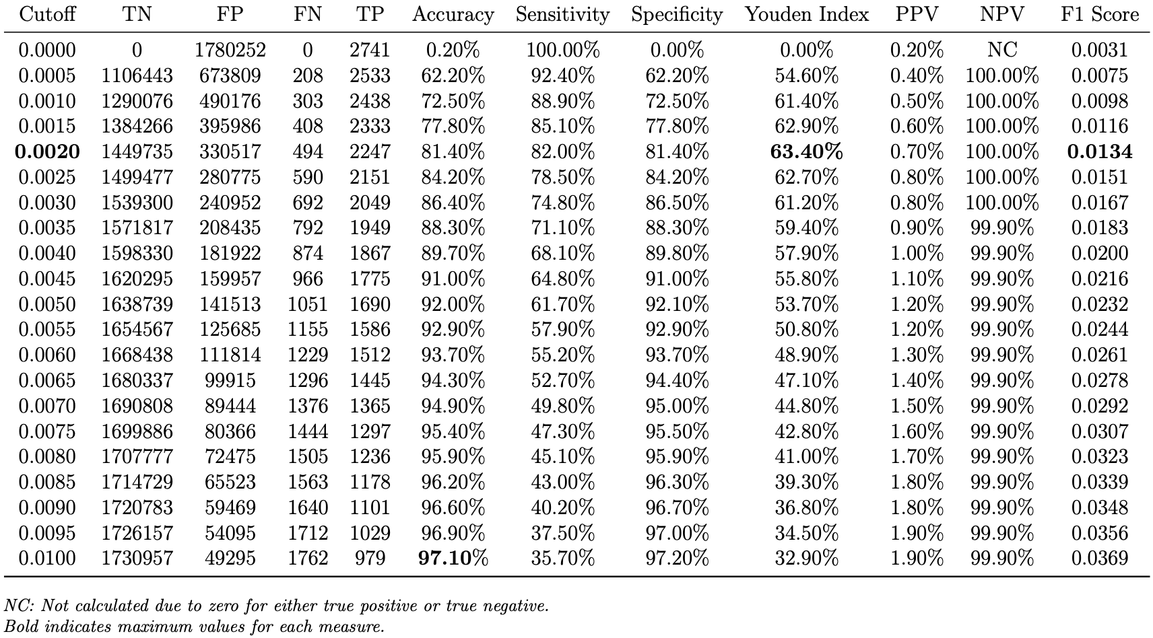
3.1 Benchmark model – Logistic Regression
Benchmark Model—Logistic Regression overall model fit
Integrating Data-Level Balancing and Enhanced RFM-Based Feature engineering for Credit Card Fraud Detection

Slide 45
3.1 Benchmark model – Logistic Regression
Model Assessment– Interpretation & Performance
Accuracy (at cutoff point 0.0020): 0.8140
F1 Score (at cutoff point 0.0020): 0.0134
Integrating Data-Level Balancing and Enhanced RFM-Based Feature engineering for Credit Card Fraud Detection

Slide 46
Towards Trustworthy Fraud Detection:
Combining Class Imbalance Mitigation and Model Interpretability
Student Name: Andy Chen, Alvin Lin, Chrissy Wang
Advisor Name: Hui Wen Teng
2025 Machine Learning & Fintech

Slide 47
3.1 Benchmark model – Logistic Regression
Appendix– candidates variables for Logistic Regression
Summary of variables
Index | Variables | Type | Index | Variables | Type
Y | Fraud_label | numeric | X₁₄ | zip_missing_flag | category
X₁ | transaction_id | numeric | X₁₅ | errors_missing_flag | category
X₃ | client_id | numeric | X₁₆ | use_chip_Chip Transaction | category
X₄ | card_id | numeric | X₁₇ | use_chip_Online Transaction | category
X₅ | amount | numeric | X₁₈ | use_chip_Swipe Transaction | category
X₇ | merchant_id | numeric | X₁₉ | fraud_label | category
X₁₀ | zip | numeric | X₂₀ | current_age | numeric
X₁₁ | mcc_code | numeric | X₂₁ | retirement_age | numeric
X₁₃ | merchant_state_missing_flag | category | X₂₄ | gender | category
Integrating Data-Level Balancing and Enhanced RFM-Based Feature engineering for Credit Card Fraud Detection

Slide 48
3.1 Benchmark model – Logistic Regression
Appendix– candidates variables for Logistic Regression
Summary of variables
Index | Variables | Type | Index | Variables | Type
X₂₆ | latitude | numeric | X₃₉ | num_cards_issued | numeric
X₂₇ | longitude | numeric | X₄₀ | credit_limit | numeric
X₂₈ | per_capita_income | numeric | X₄₄ | card_type_Credit | category
X₂₉ | yearly_income | numeric | X₄₅ | card_type_Debit | category
X₃₀ | total_debt | numeric | X₄₆ | card_type_Debit (Prepaid) | category
X₃₁ | credit_score | numeric | X₄₇ | card_brand_Amex | category
X₃₂ | num_credit_cards | numeric | X₄₈ | card_brand_Discover | category
X₃₅ | card_number | numeric | X₄₉ | card_brand_Mastercard | category
X₃₇ | cvv | numeric | X₅₀ | card_brand_Visa | category
X₃₈ | has_chip | category | X₅₁ | fraud_label_missing_flag | category
Integrating Data-Level Balancing and Enhanced RFM-Based Feature engineering for Credit Card Fraud Detection

Slide 49
3.1 Benchmark model
Andy 大綱草稿頁
Why choose Logistics Regression as our Baseline model? (Property and assumptions– linearity of logit, independence of observations)
Introduce independents variables and the dependent variables
To meet the multicollinearity assumption (a) – drop one hot encoding variables
(b) VIF index to check multicollinearity among variables
Overview the variables we might choose (univariate tests of each independent variable)
Stepwise methods to choose variables
Diagnostics （ROC curve）
The final base model
*Check linearity of logit (V)
Integrating Data-Level Balancing and Enhanced RFM-Based Feature engineering for Credit Card Fraud Detection

